Slide 1
Chapter 7
Linear Momentum and Collisions

Slide 2
Intended Learning Outcomes
To apply the concept of linear momentum in isolated and non-isolated systems
To solve problems of collisions in one dimension and two dimensions
To identify the center of mass of different systems

Slide 3
Newton’s Laws and Conservation law
Consider an isolated system of two particles with masses m1 and m2 moving with velocities and at an instant of time.
Since the system is isolated, the only force on particle 1 is that from the particle 2 and vice versa (action and reaction forces according to Newton’s third law).
From Newton’s second law,
is conserved (a constant).

Slide 4
Conservation of Linear Momentum
If we define the linear momentum (or momentum, ) of a particle of mass m moving with a velocity to be the product of the mass and velocity:
If there is no net external force acting on a system, the total momentum of the system remains constant.
is a vector and has a unit of kgms⁻¹.

Slide 5
Newton’s Second Law and Momentum
Using the definition of momentum, we can rewrite Newton’s second law as the following:
i.e. the effect of a net force on a system is to change its linear momentum.

Slide 6

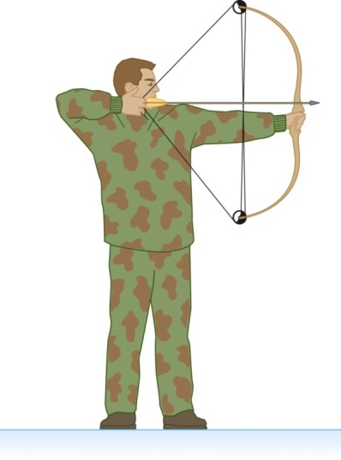
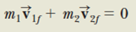
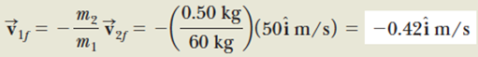
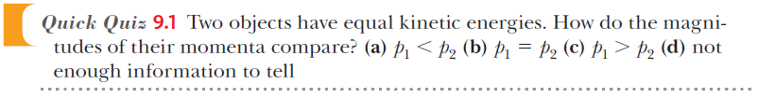
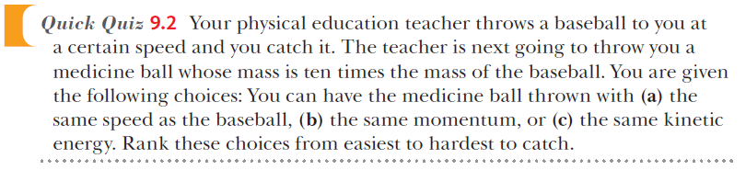
A 60kg man stands at rest on frictionless ice and fires a 0.50 kg arrow at 50 ms⁻¹. Determine the speed of the man after firing.
Notes:
QQ9.1 (d)
QQ9.2 (b),(c),(a)

Slide 7
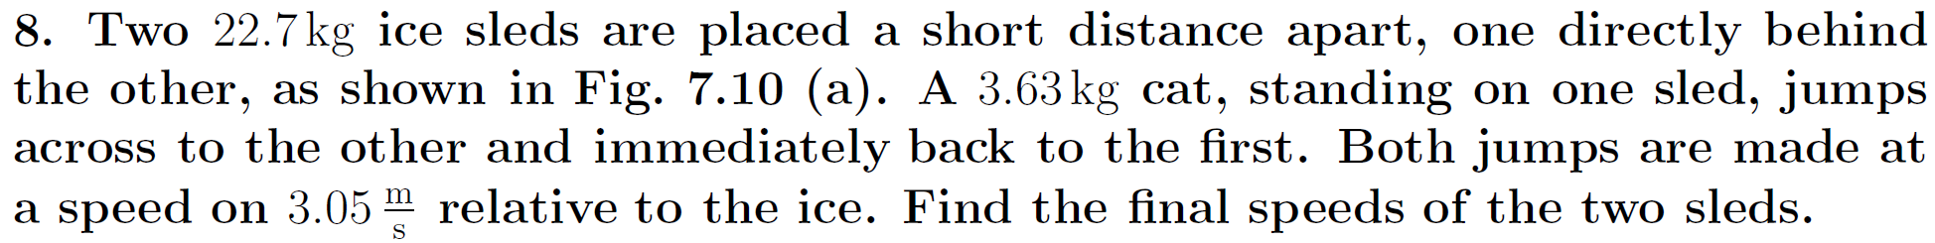
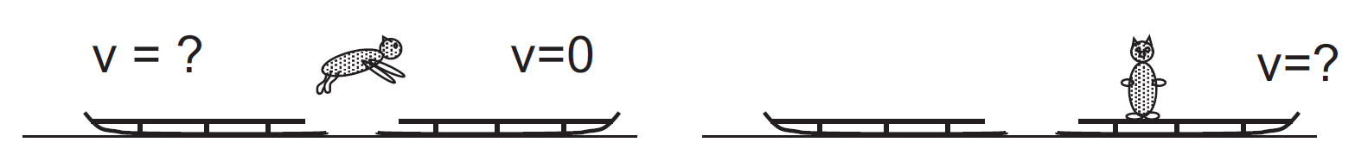
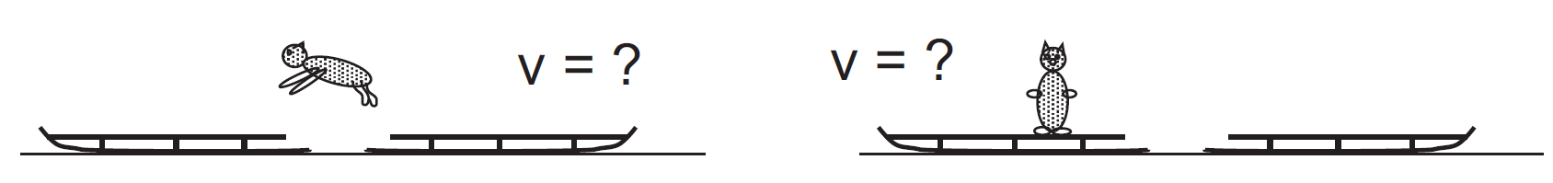
Challenging Question

Slide 8
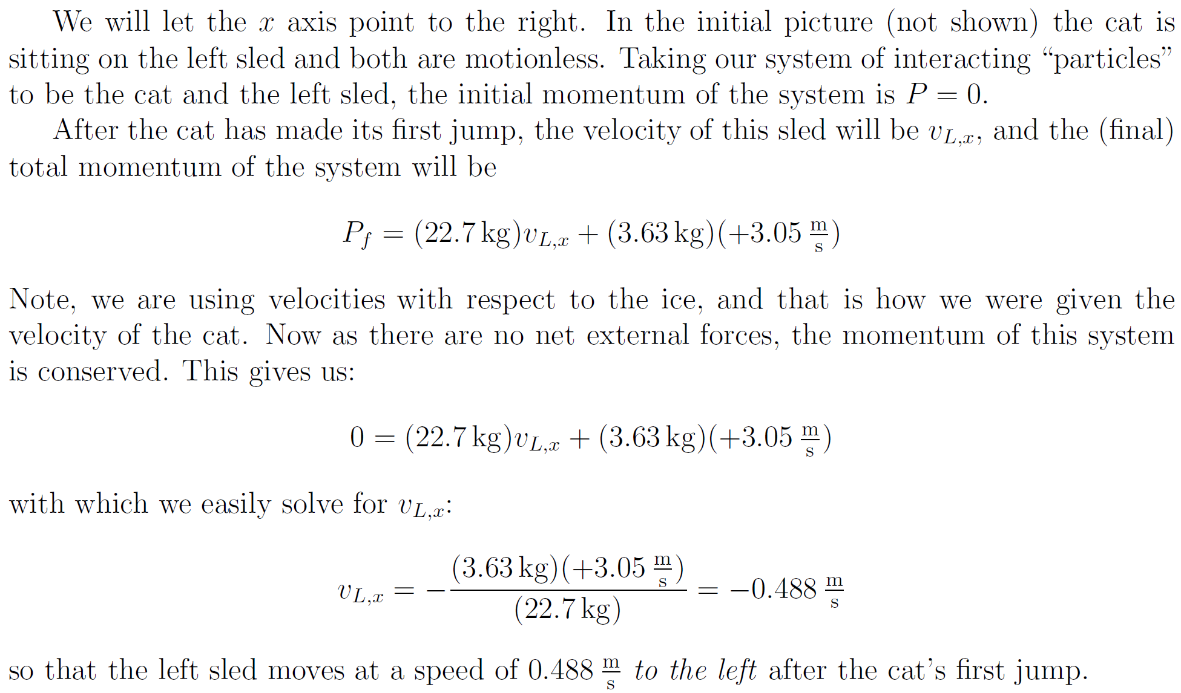

Slide 9
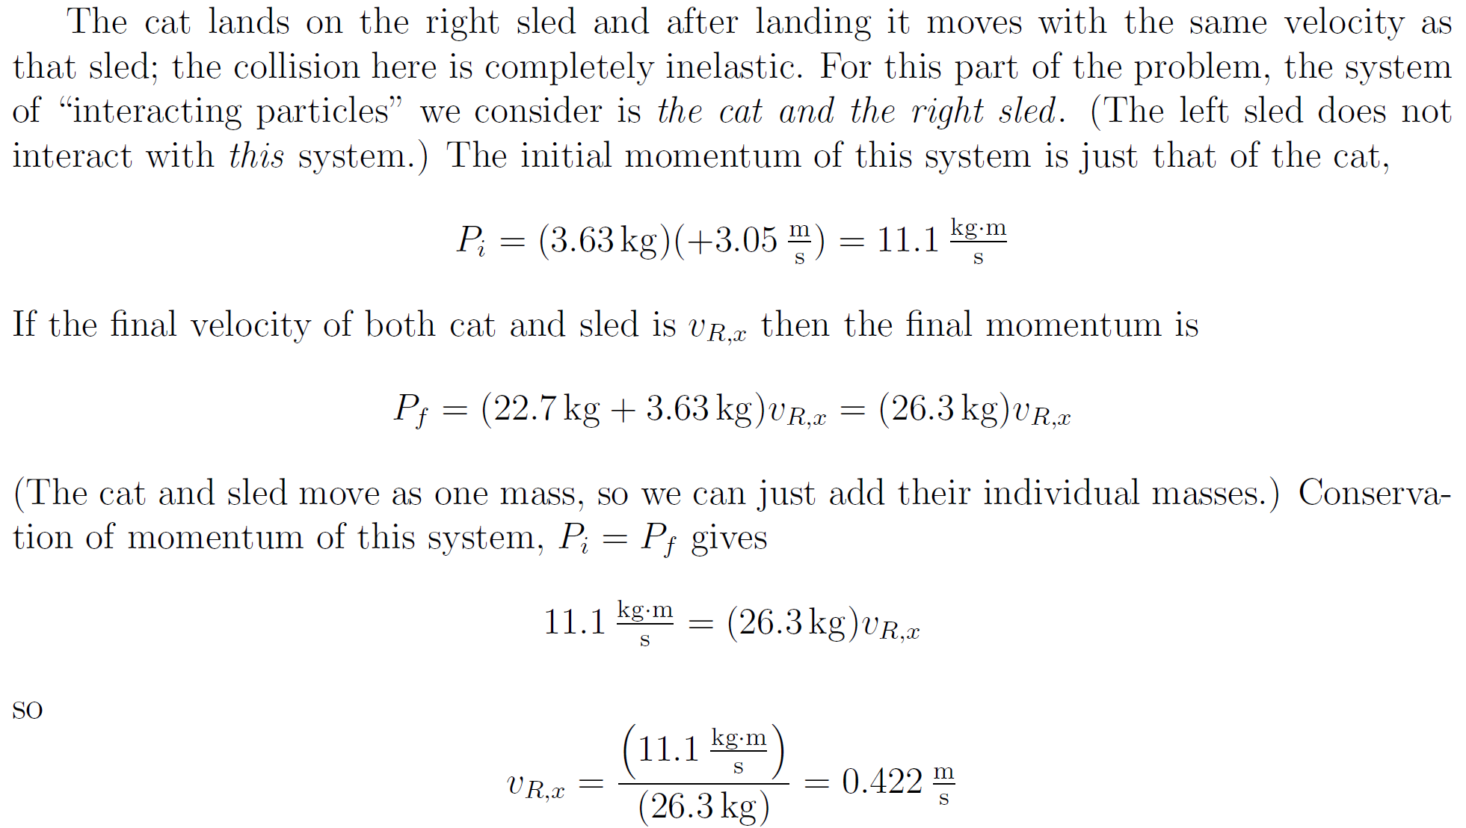

Slide 10
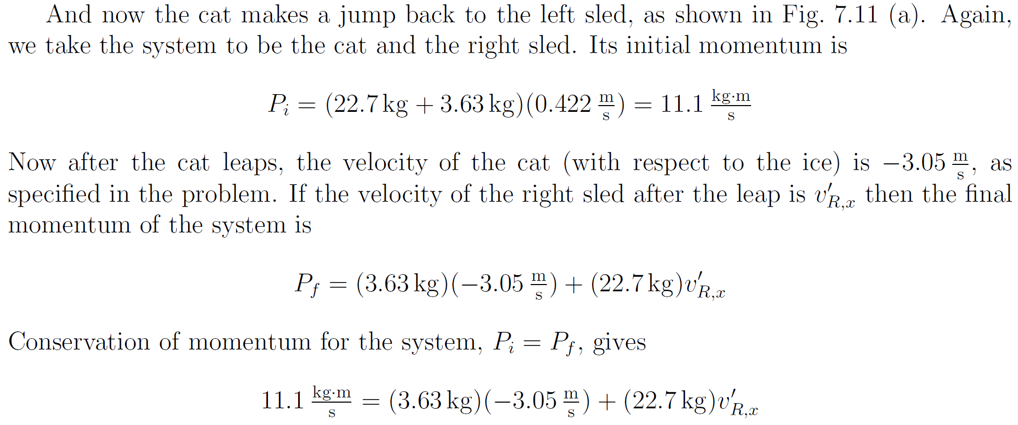
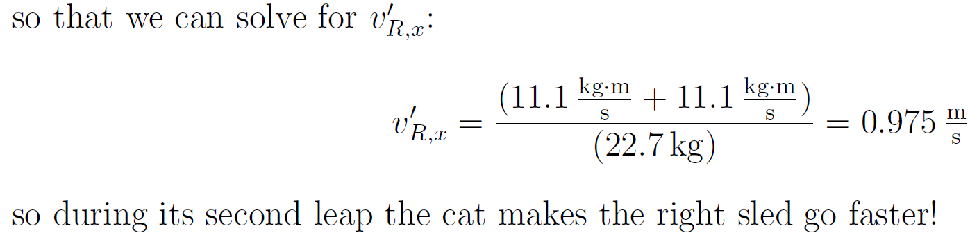

Slide 11
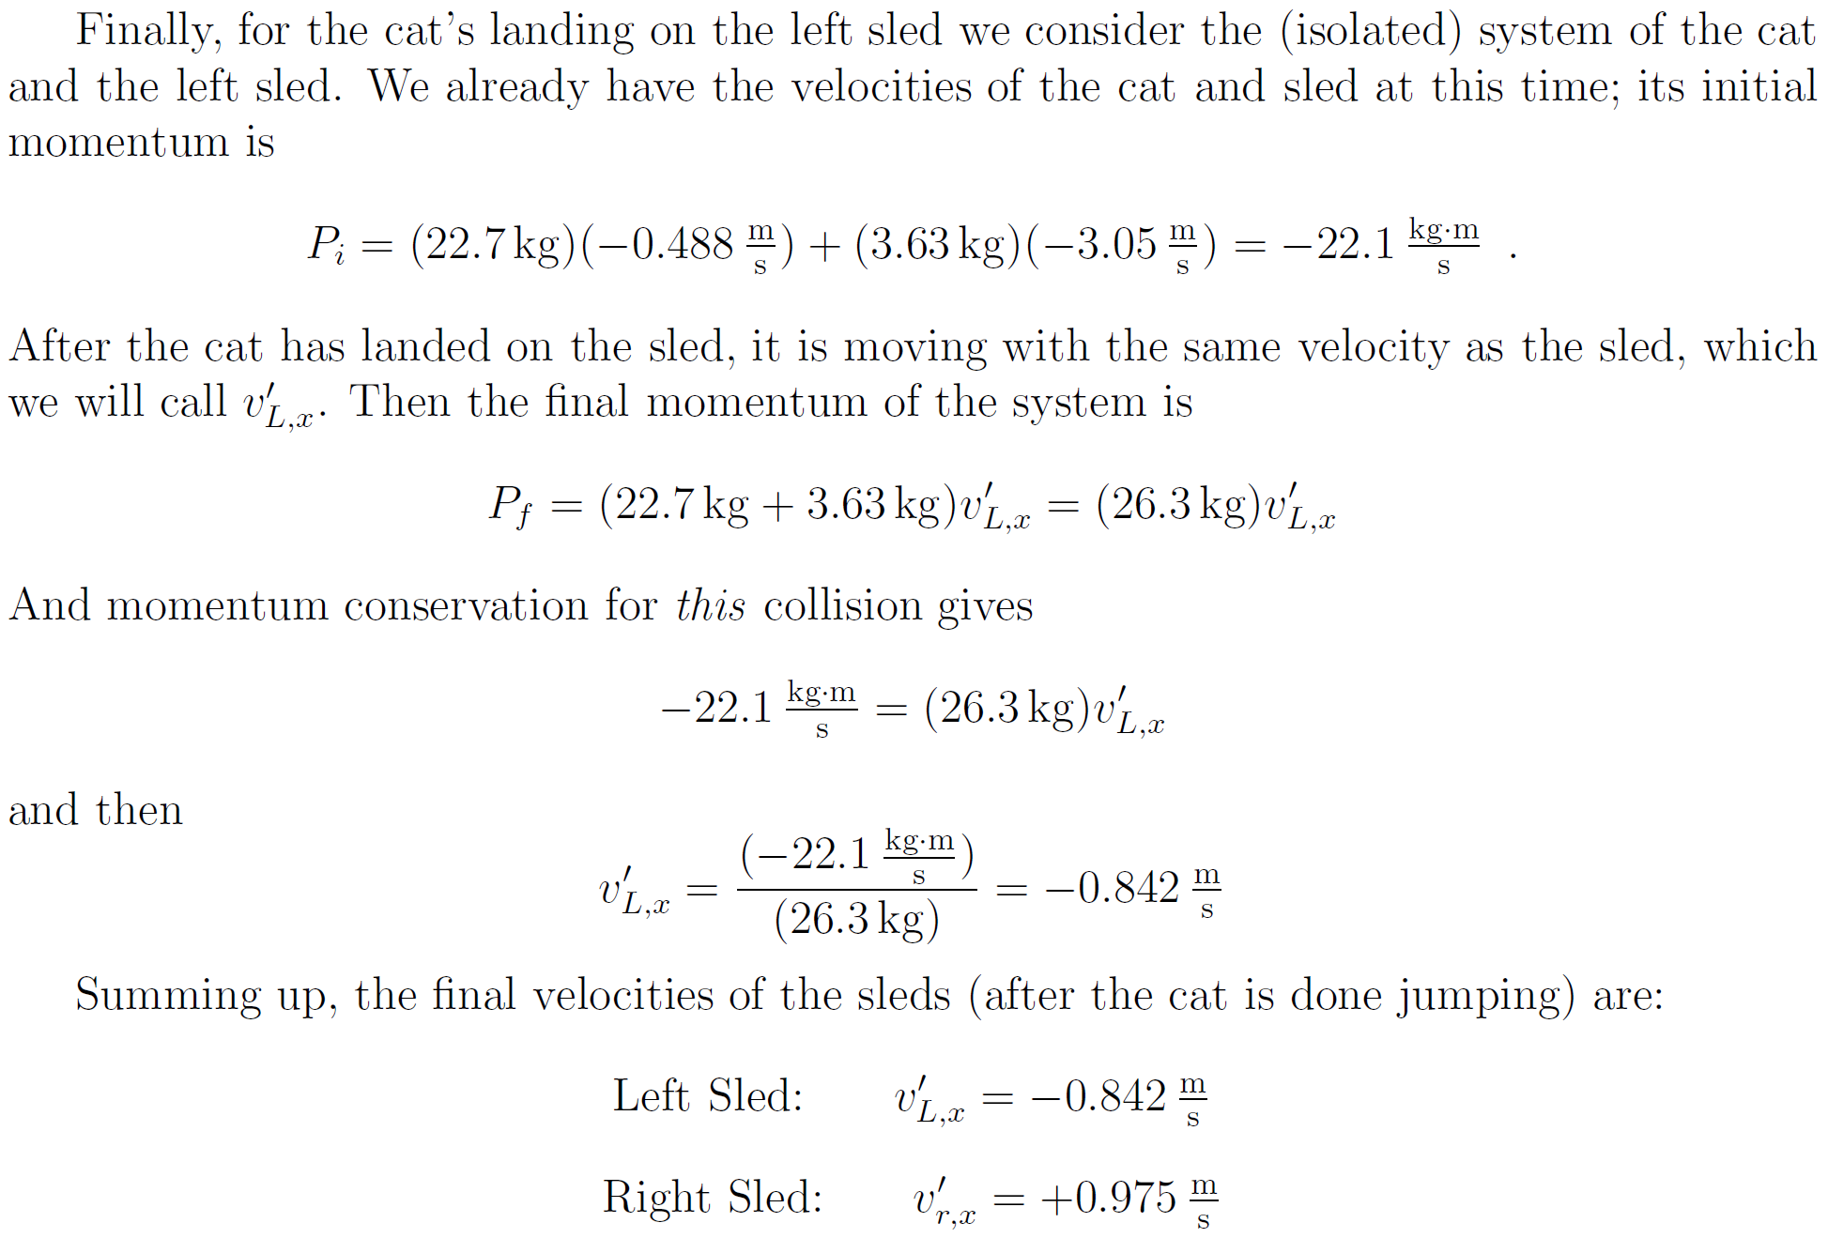

Slide 12
Impulse and Momentum
The momentum of a system changes if a net force from the environment acts on the system.
From Newton’s Second Law,
Solving for gives
Integrating to find the change in momentum over some time interval.
The integral is called the impulse, , of the force acting on an object over Δt.

Slide 13
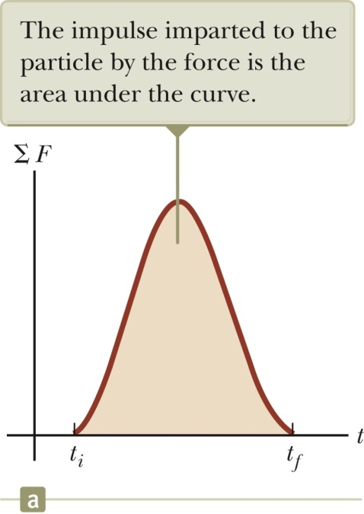
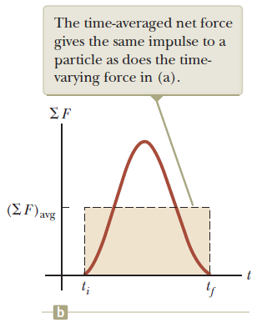
More About Impulse
Impulse is a vector quantity.
The magnitude of the impulse is equal to the area under the force-time curve.
The force may vary with time.
Impulse is a measure of the change in momentum of the particle.
The impulse can also be found by using the time averaged (impulsive) force.
This would give the same impulse as the time-varying force does.

Slide 14
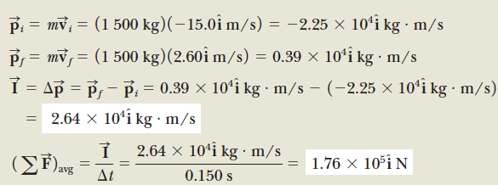
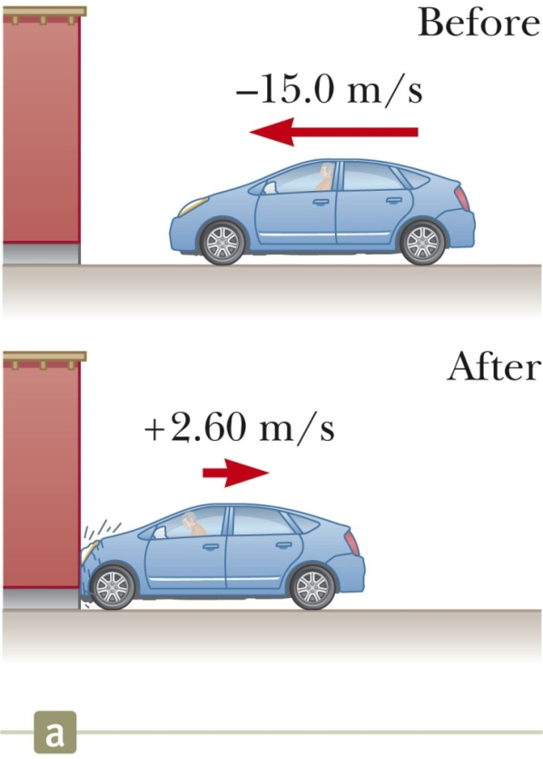
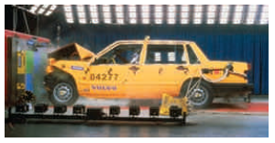

Slide 15
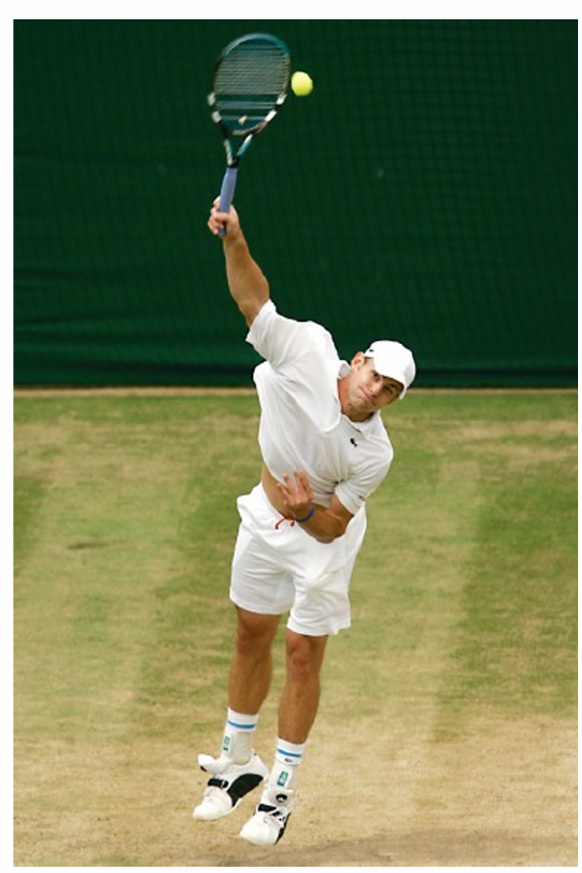
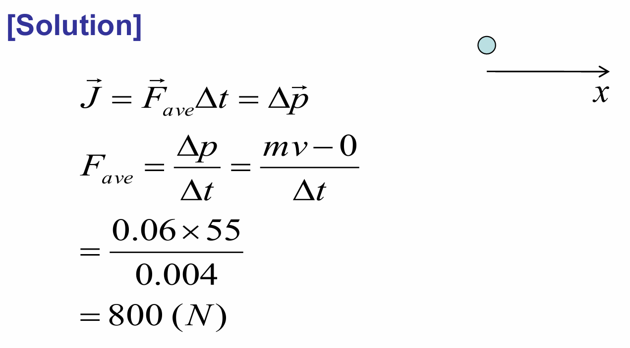
For a top player, a tennis ball may leave the racket on the serve with a speed of 55 m/s (about 120 mi/h). If the ball has a mass of 0.060 kg and is in contact with the racket for about 4 ms (4 x 10⁻³ s), estimate the average force on the ball.

Slide 16
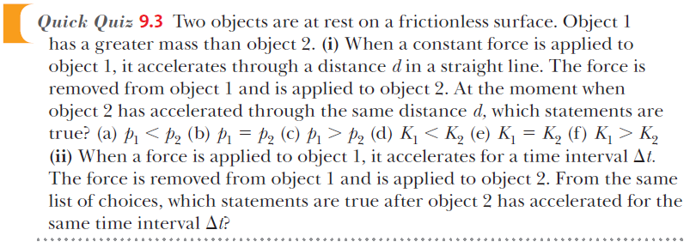
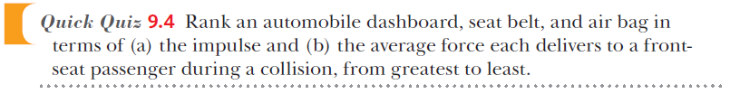
Notes:
QQ9.3 (i) (c),(e) (ii) (b),(d)
QQ9.4 (a) All three are the same. (b) dashboard, seat belt, air bag

Slide 17
Collisions – Characteristics
The term collision represents an event during which two particles come close to each other and interact by means of forces.
Direct physical contact is not necessary
The interaction forces are assumed to be much greater than any external forces present.
This means the impulse approximation can be used.

Slide 18
Types of Collisions
In an elastic collision, momentum and kinetic energy are conserved.
Perfectly elastic collisions occur on a microscopic level.
In macroscopic collisions, only approximately elastic collisions actually occur.
In an inelastic collision, kinetic energy is not conserved, although momentum is still conserved.
If the objects stick together after the collision, it is a perfectly inelastic collision.
Momentum is conserved in all collisions

Slide 19
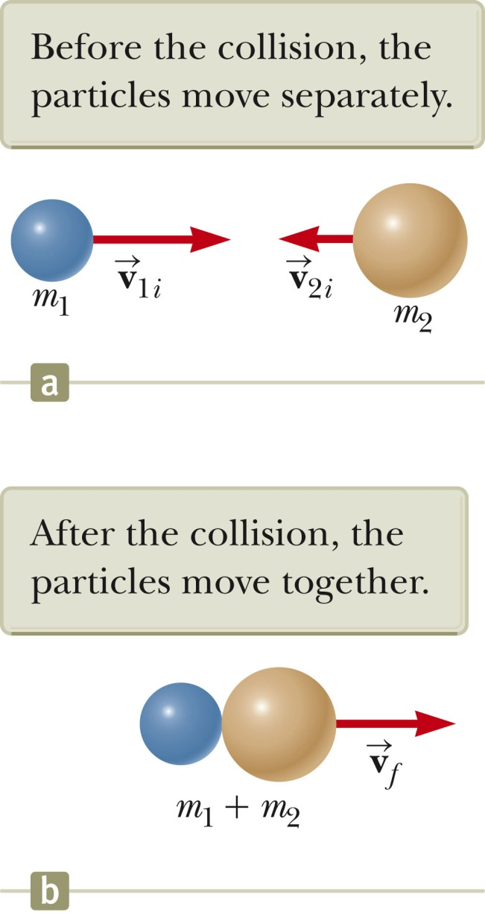
Perfectly Inelastic Collisions

Slide 20
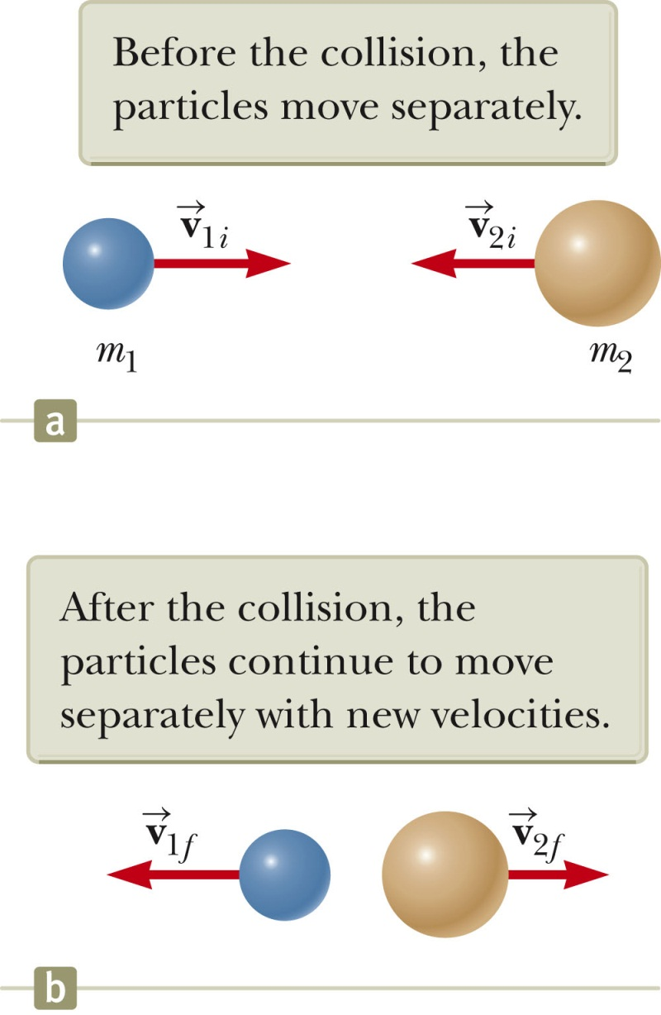
Elastic Collisions
Both momentum and kinetic energy are conserved.
Typically, there are two unknowns to solve for and so you need two equations.

Slide 21
Elastic Collisions
For one dimensional case,
KE:
Momentum:

Slide 22
Elastic Collisions, Special Cases:
S.C. 1:
Exchange velocities.
If m₁>>m₂,
S.C. 2:
If m₂>>m₁,

Slide 23
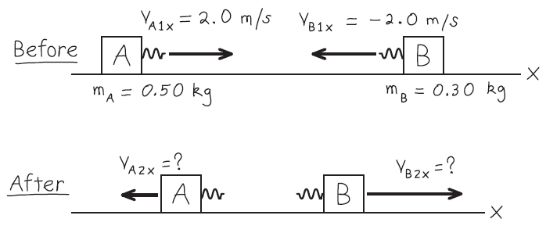
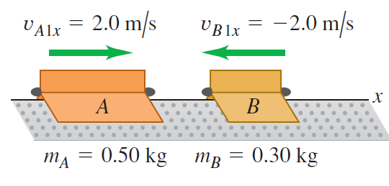
Example : Elastic straight-line collision
We repeat the air-track collision of Example 8.5 (Section 8.2), but now we add ideal spring bumpers to the gliders so that the collision is elastic. What are the final velocities of the gliders?

Slide 24
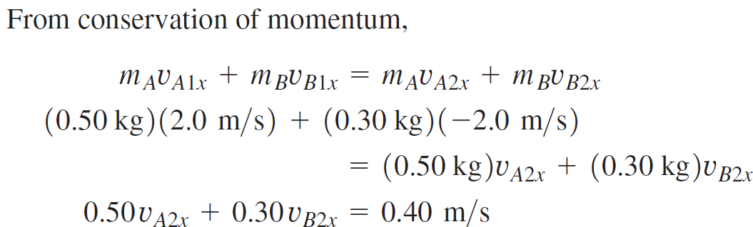
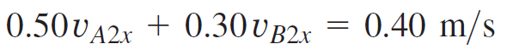
Example : Elastic straight-line collision
We repeat the air-track collision of Example 8.5 (Section 8.2), but now we add ideal spring bumpers to the gliders so that the collision is elastic. What are the final velocities of the gliders?
Plug in numbers:
Simplify to:

Slide 25
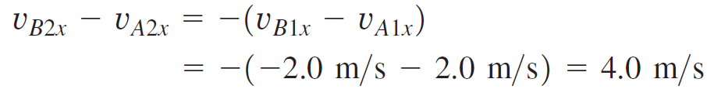
Example : Elastic straight-line collision
We repeat the air-track collision of Example 8.5 (Section 8.2), but now we add ideal spring bumpers to the gliders so that the collision is elastic. What are the final velocities of the gliders?
Solving these equations simultaneously, we find

Slide 26
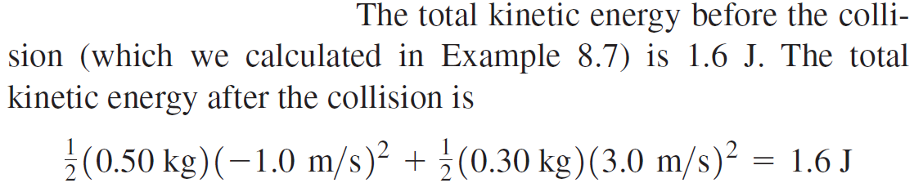
Example : Elastic straight-line collision

Slide 27
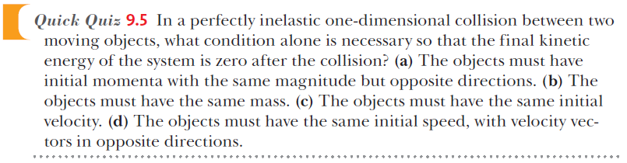
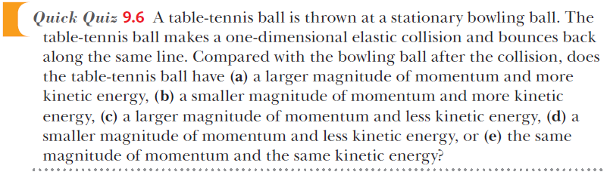
Notes:
QQ9.5 (a)
QQ9.6 (b)

Slide 28
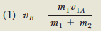
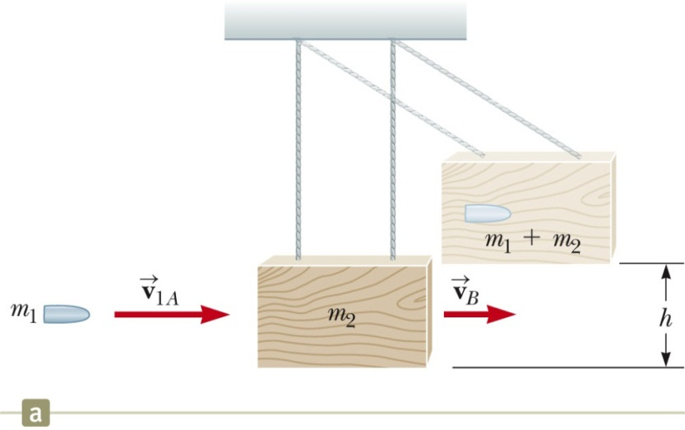
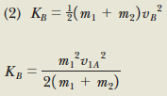
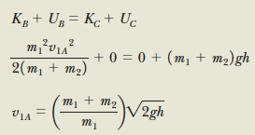
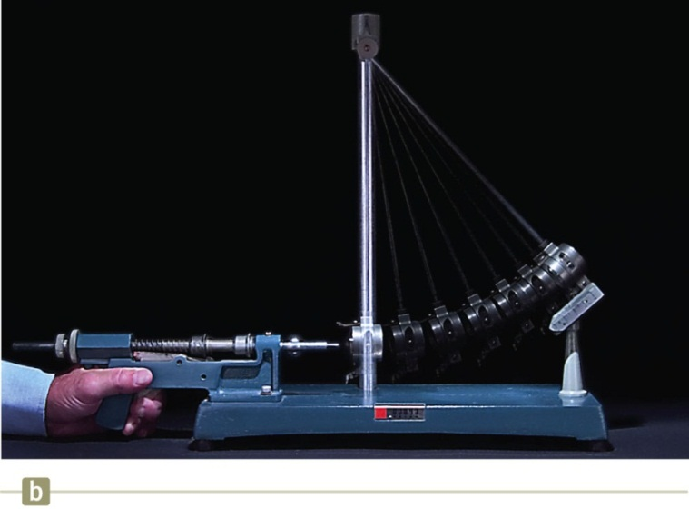
Conservation of momentum:
KE after collision:
Conservation of energy in stage of BC:

Slide 29
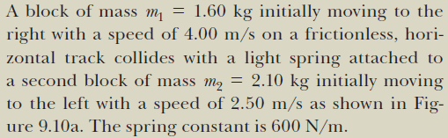
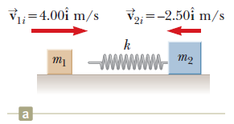
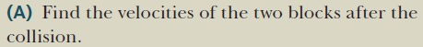
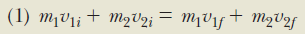
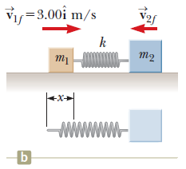
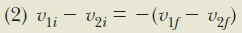
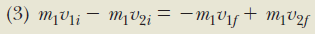
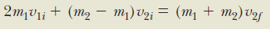
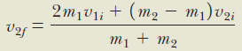

Slide 30
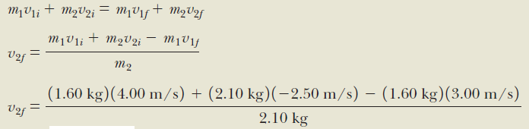
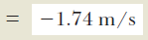
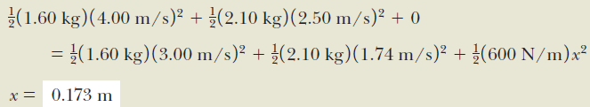

Slide 31
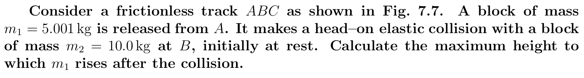


Slide 32



Slide 33


Slide 34


Slide 35



Two-Dimensional Collision

Slide 36




Slide 37

The Center of Mass
There is a special point in a system or object, called the center of mass, that moves as if all of the mass of the system is concentrated at that point.
The system will move as if an external force were applied to a single particle of mass M located at the center of mass.
M is the total mass of the system.
This behavior is independent of other motion, such as rotation or vibration, or deformation of the system.
This is the particle model.
http://blogs.exploratorium.edu/passionately-curious/about/

Slide 38


Slide 39


Slide 40





Center of Mass, Coordinates
The coordinates of the center of mass are
M is the total mass of the system.
For continuous mass distributions,

Slide 41


Slide 42


Slide 43


Slide 44



Slide 45





Motion of a System of Particles
Assume the total mass, M, of the system remains constant.
We can describe the motion of the system in terms of the velocity and acceleration of the center of mass of the system.
We can also describe the momentum of the system and Newton’s Second Law for the system.

Slide 46
Center of Gravity
Each small mass element of an extended object is acted upon by the gravitational force.
The net effect of all these forces is equivalent to the effect of a single force acting through a point called the center of gravity
If is constant over the mass distribution, the center of gravity coincides with the center of mass.

Slide 47

Finding Center of Gravity, Irregularly Shaped Object
Suspend the object from one point.
Then, suspend from another point.
The intersection of the resulting lines is the center of gravity and half way through the thickness of the wrench.

Slide 48


Notes:
QQ9.7 (b)
QQ9.8 (i) (a) (ii) (b)

Slide 49





Summary

